Slide 1

ECEN 3593-001 Computer Organization
Lecture #1
15 January 2021

Slide 2


Introductions
Steve Sheafor
Email address: Stephen.Sheafor@Colorado.edu
Please use Slack for communications – NOT Email
Office hours: M/W 2:00-3:00pm on Zoom (will expand later), by appointment, and via Slack
Send me a Slack message if you want to talk during my normal OH
ELAs
Kaiyuan Hou – Office Hours TBD on Zoom
Xavion Cowans – Office Hours TBD on Zoom

Slide 3
Agenda
Class Announcements
Introduction
Course Goals

Slide 4
Class Announcements
Codasip NDA – Sign via Docusign
22 people have not submitted their signed NDAs
You cannot start the class project until this is received
Let me know ASAP if you have any difficulty signing
Slack
Everyone has been invited to the class Slack chat
13 people have not accepted the Slack invitation
Participation in this is required – please respond immediately
Invitations were made to your First.Last@Colorado.edu Email addresses – let me know if you need an invitation to your Identikey@Colorado.edu Email address
Monday is Martin Luther King Day – no class

Slide 5
Zoom
Please enable video if possible
Keep audio muted
Unmute to ask questions
There will be some experimentation in the early classes
Recordings and class presentations will be posted on Canvas

Slide 6
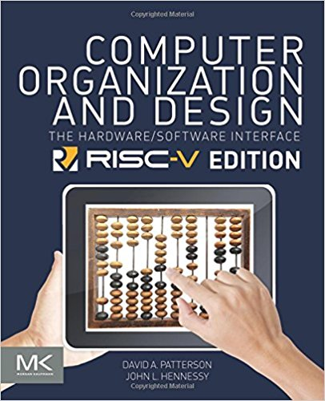
Computer Organization and Design RISC-V Edition 1st Edition The Hardware Software Interface Authors: David Patterson John Hennessy eBook ISBN: 9780128122761 Paperback ISBN: 9780128122754
Required Text Book

Slide 7
Analyzing the Book Title
Computer Organization and Design: The Hardware/Software Interface
Computer Organization

Slide 8
Analyzing the Book Title
Computer Organization and Design: The Hardware/Software Interface
Computer Organization -> Computer Architecture
Design – design and architecture are tightly coupled
Hardware/Software Interface – understanding software (in particular the Instruction Set Architecture – ISA) is critical

Slide 9
Course Goals
Develop an understanding of many high level computer architecture principles (textbook + lectures)
Develop a detailed understanding of a specific, modern processor architecture – RISC-V (textbook + course project)
Complete a project similar to a typical commercial project (course project)

Slide 10
Computer Architecture
What Comprises Computer Architecture?
The Processor – instruction set, registers, data paths, performance
The Memory – type(s), hierarchies, sizes, performance
The External Connections (I/O) – type, number, performance
Special Functions – accelerators, data movement controllers
The System – how everything ties together
The Software – how everything is controlled
Why Study Computer Architecture?
Success is optimizing Performance/Power/Cost/Development Cost & Time
All are heavily impacted by the architecture
The big challenges are at the intersection of hardware and software, which is the domain of the architect
The Architect drives the key decisions for a wide variety of products

Slide 11
Introduction: Steve Sheafor
Education:
BA (EE/Math/Economics) – Rice University 1972
MEE – Rice University 1972
Ph.D. (EE) – University of Illinois 1974
MBA – University of Santa Clara 1979
Industry Experience:
Development Engineer/Manager (Hewlett Packard)
Founder/Chief Technology Officer/Board Member (Three companies)
Startup Employee/Advisor/Angel Investor/Board Member (~12 companies)

Slide 12
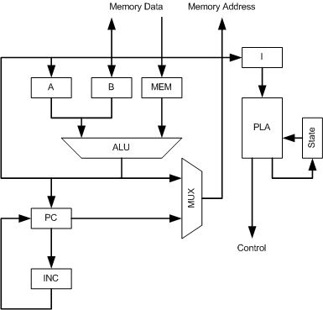
Hewlett Packard 1000 L-Series (1980)
First HP integrated circuit processor for a minicomputer
Designed in Silicon on Sapphire (SOS) – today Silicon on Insulator (SOI)
~4,500 transistors, three years of design/development
Drew schematics by hand
Drew transistors by hand
Simulated operations by hand
1.6 MHz
Hardwired processor (PLA control), two registers, indirect memory addressing (1 MB)
Instruction Set compatible with previous generations, so software (OS/Compilers) existed
Computer Architecture was the CPU implementation

Slide 13
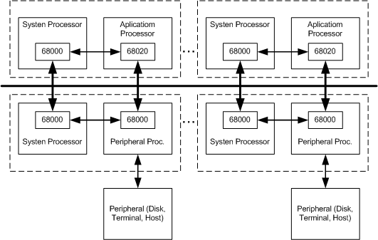
Dialogic Systems DS25 (1983)
Terminal interaction accelerator for mainframes
Multiple commercial microprocessors (Motorola 68000/68020) 10-20 MHz
Developed our own OS due to multiple processors (and processor types)
Custom compilers, which were slow and complex to create
Software was an overwhelming problem
Computer Architecture was the patented multiprocessor interconnect
Raised $48M ($135M today) and failed due to complexity of software

Slide 14
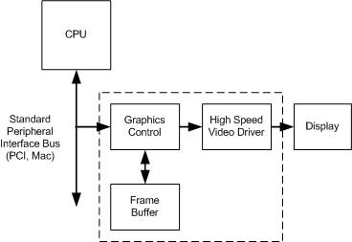
Cornerstone Graphics Controllers (1988)
Personal Computer peripheral interconnection to high resolution displays
Multiple configurable ASICs (up to 267 MHz)
Software all runs on the PC – high quality tools exist
Only custom software required was the drivers
Developed ~220 unique controllers from 3 generations of ASICs
Computer Architecture was the data movement acceleration (HW/SW) and the flexibility of design
Raised $9M, IPO at $220M

Slide 15
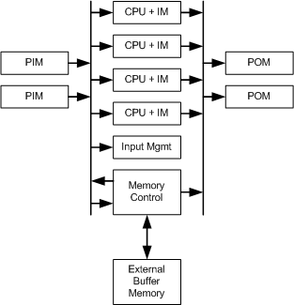
Sitera IQ2000 (2000)
Network processor for network equipment manufacturers (e.g. Cisco routers)
System on Chip (SOC) with 4 custom RISC processors (200 MHz)
Similar to commercial MIPS processors
Specialized networking peripheral modules
Off-chip data storage memory (Rambus), on-chip instruction memories
Patented on-chip interconnection system
Software tools had to be developed from scratch
Assembler
Debugger
Compiler
Compiler was complex, so most programming in Assembly Language
Computer Architecture was the CPU, data flow and on-chip interconnection
Raised $24M, acquired for $750M

Slide 16
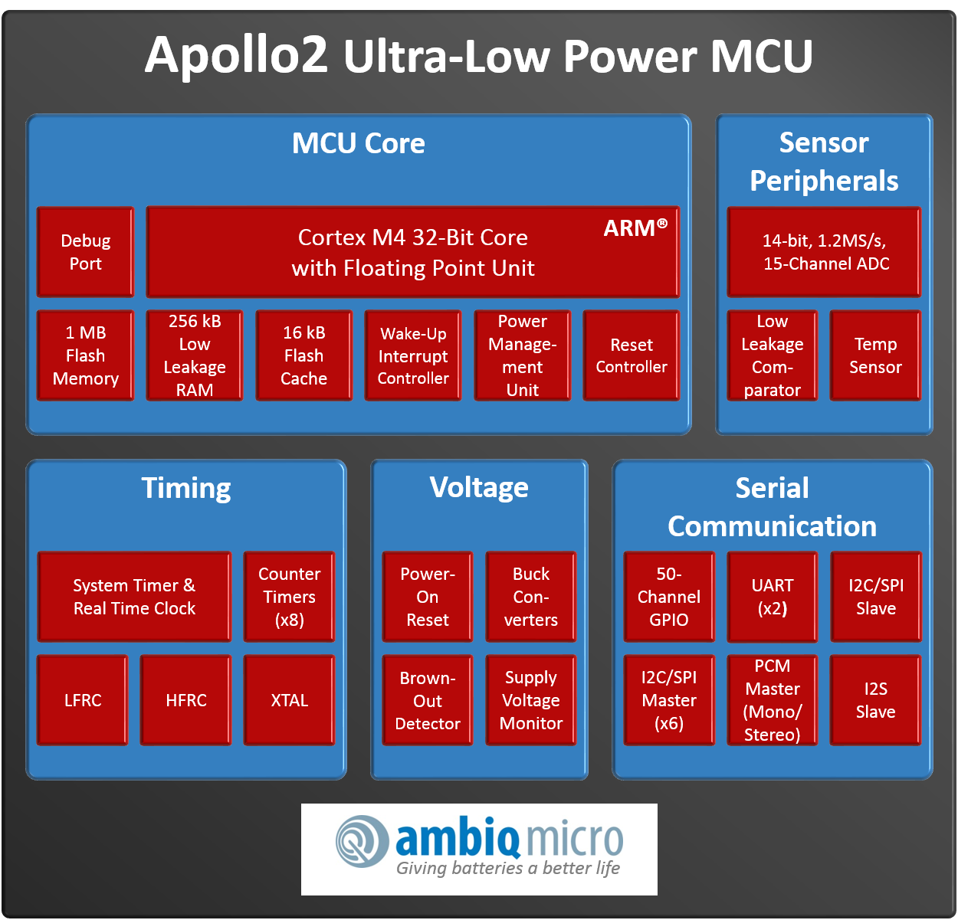
Ambiq Micro Apollo1/2/3 family (2014)
World’s lowest power microcontrollers
Processor is an ARM M4 in an SOC, standard ARM APB/AHB interconnection (48/96 MHz)
Hard to differentiate from competitors
Software tools supplied by ARM – well known
Multiple specialized peripheral modules, large on-chip memories
Low power through patented circuit technology (U of M), but architectural innovations are still important
Computer Architecture was the peripheral module design and drivers
But – understanding the ARM CPU architecture is essential for designing/debugging/verifying these modules
Has raised $150M, in operation

Slide 17
Ambiq Micro Apollo4 family (2020)
World’s lowest power microcontrollers with higher performance
Main processor is still ARM, but specialized processors added to reduce power and increase performance (Tensilica, RISC-V, etc.) and provide parallel operations with Digital Signal Processors (DSPs)
New compilers/debuggers automatically generated if necessary
Computer Architecture is the specialized CPUs and the parallel data flow

Slide 18
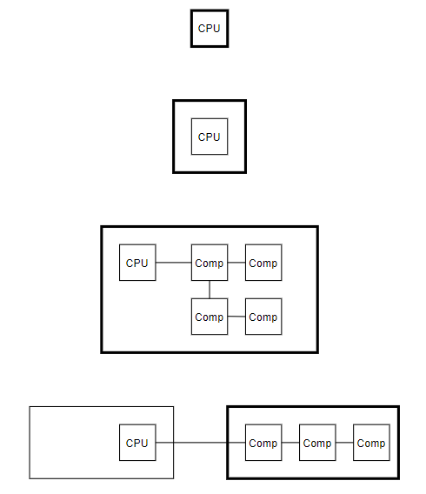
CPU is Always Important
Design the Processor (HP, Sitera)
Integrate the Processor (Ambiq)
Use the Processor (Dialogic)
Connect to the Processor (Cornerstone)

Slide 19
Next Class
Class Structure
Class Project
Codasip Demo

